Slide 1

ORIZONT 2020
IMM-urile și inovarea.
Instrumentul pentru IMM-uri şi instrumentul financiar –
în ORIZONT 2020
Dr.ing. Camelia-Elena MARINESCU
PNC-IMM si
PNC-Acces la Finantarea de Risc
pentru ORIZONT 2020
Consilier Superior MINISTERUL EDUCATIEI NATIONALE Str.Mendeleev, Nr.21-25, Sect.1, Bucuresti ROMANIA
tel: +40 21 316.29.77 fax: +40 21 318.30.71 mobil: +40 21 744-82.04.00
www.research.edu.ro

Slide 2


https://ec.europa.eu/easme/en The EASME replaces the EACI (Executive Agency for Competitiveness and Innovation). Programmes - Most of COSME, the EU programme for the Competitiveness of Enterprises and Small and Medium-sized Enterprises (SMEs), including Enterprise Europe Network (EEN), Your Europe Business; - Part of Horizon 2020, the EU Framework Programme for Research and Innovation, and in particular: - Part II 'Industrial leadership': -Innovation in SMEs (including the European IPR Helpdesk) -The Sustainable Industry Low Carbon Scheme (SILC II) - part of the Leadership in Enabling and Industrial Technol - Part III 'Societal challenges': -The Energy Efficiency part of the challenge ‘Secure, Clean and Efficient Energy’; -The calls for proposals in the fields of waste, water innovation and sustainable supply of raw material under the challenge ‘Climate action, Environment, Resource Efficiency and Raw Materials’ - The SME instrument Part of the EU programme for the Environment and Climate action (LIFE) Part of the European Maritime and Fisheries Fund (EMFF) The legacy of the Intelligent Energy – Europe programme and the Eco-innovation initiative
Executive Agency for Small and Medium-sized Enterprises (EASME)
Forumul Inovarii, Bucuresti 16 octombrie 2014

Slide 3
Horizon 2020 for SMEs
Collaborative Projects
13%
Enhancing Innovation Capacity
Eurostars II
InnovFin – EU Finance for Innovators
& accompanying measures
Fellowships
(Access to Skills)
SME Instrument
7%
20 % budgetary
target in LEITs (IL) & SC*
'Innovation in SMEs' (IL)
'Access to Risk Finance' (IL)
MSCA (ES)
*= ~ EUR 9 billion of direct SME support. over the period 2014-2020

Slide 4
An Encouraging Start!
9 months into Horizon implementation. SMEs represent…
1/4 of applicants (24.82%)
1/5 of beneficiaries (19.55%)
1/6 of budget allocation (16.18%)
What about the target (set by Council and EP) to allocate 20% of the budget for Societal Challenges and LEITs to SMEs?
For Societal Challenges. we are at close to 12% (11.98%)
For LEITs. we are at about 21.4% (21.46%)
For both together we are currently at 18.12%
This while the full impact of SME instrument funding has not kicked in yet (no phase 2 yet)
On the basis of an extrapolation taking into account the full impact of SME instrument phase 2, it can be assumed that the target will be exceeded by 2-3% for 2014-2015
Notes:
Only for-profit SMEs established in the EU or associated countries may apply
Seek advice by support networks EEN and NCP

Slide 5
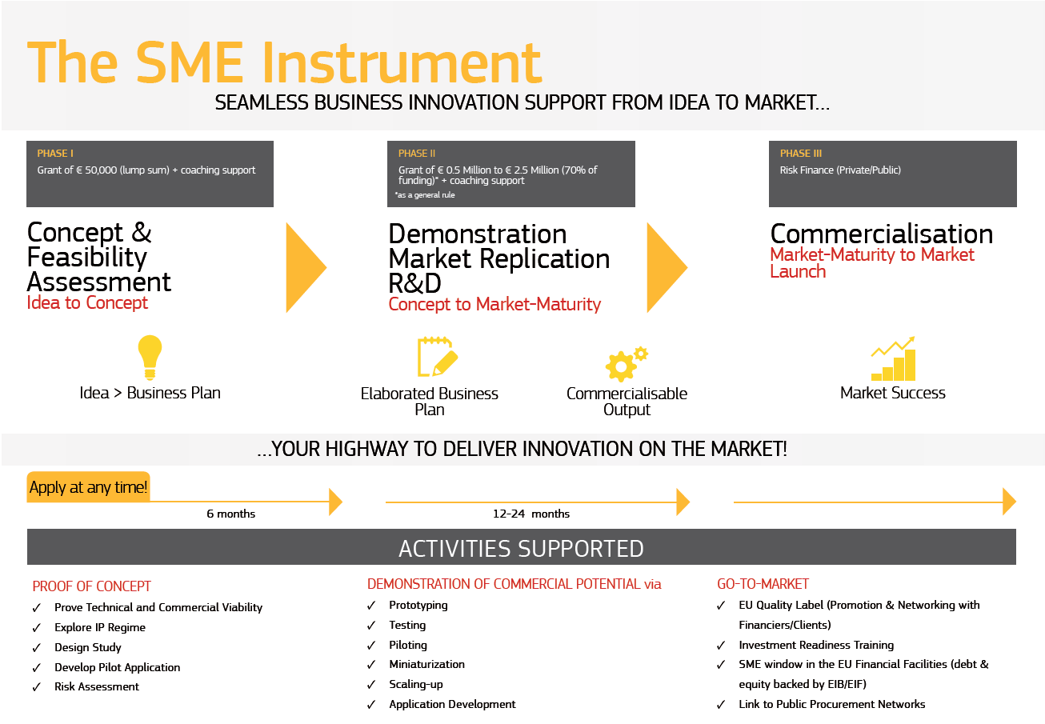
2% budget
10% budget
88% budget

Slide 6
Themes for 2014-2015
In 2014 and 2015 the SME Instrument will sponsor SMEs operating within 13 themes:
ICT: open disruptive innovation
Nanotech, or other advanced tech for manufacturing and materials
Space research and development
Diagnostics devices and biomarkers
Sustainable food production and processing
Blue growth
Low carbon energy systems
Greener and more integrated transport
Eco-innovation and sustainable raw material supply
Urban critical infrastructure
Biotechnology-based industrial processes
Mobile e-government applications (2015 only)
SME business model innovation (2015 only)
Notes:
Only for-profit SMEs established in the EU or associated countries may apply
Seek advice by support networks EEN and NCP

Slide 7
Implementation
Implemented centrally by one agency (EASME)
Continuously open call with around 4 cut-off dates per year
2014 2015
Phase 1 Phase 1
18/06/2014 18/03/2015
24/09/2014 17/06/2015
17/12/2014 17/09/2015
16/12/2015
Phase 2 Phase 2
09/10/2014 18/03/2015
17/12/2014 17/06/2015
17/09/2015
16/12/2015

Slide 8
1st Cut-off date 18 June 2014:
2662 proposals
2503 single company applications. 119 consortia with 2 SMEs. 34 with 3 SMEs. 6 with 4 SMEs
Italy was the country with the highest number of proposals submitted (436), closely followed by Spain (420), UK (232) and Germany (188),
France (167) and Hungary (166)
The Open Disruptive Innovation (ODI) topic attracted by far the highest number of applications with 885. followed by low carbon energy systems (372). nanotechnologies (305) and eco-innovation/raw materials (241)
2nd Cut-off date 24 September 2014:
1944 proposals
The ranking by country remains the same as in June. with Italy in the lead in terms of number of applications (351). followed by Spain (283), United Kingdom (149), Germany (128), France (93) and Hungary (91)
Open Disruptive Innovation (ODI) attracted again the biggest number of proposals (608), also followed by low carbon energy systems (268), nanotechnologies (234) and eco-innovation/raw materials (199)
No further information yet on applicants
SME Instrument – Phase 1 - Submission

Slide 9
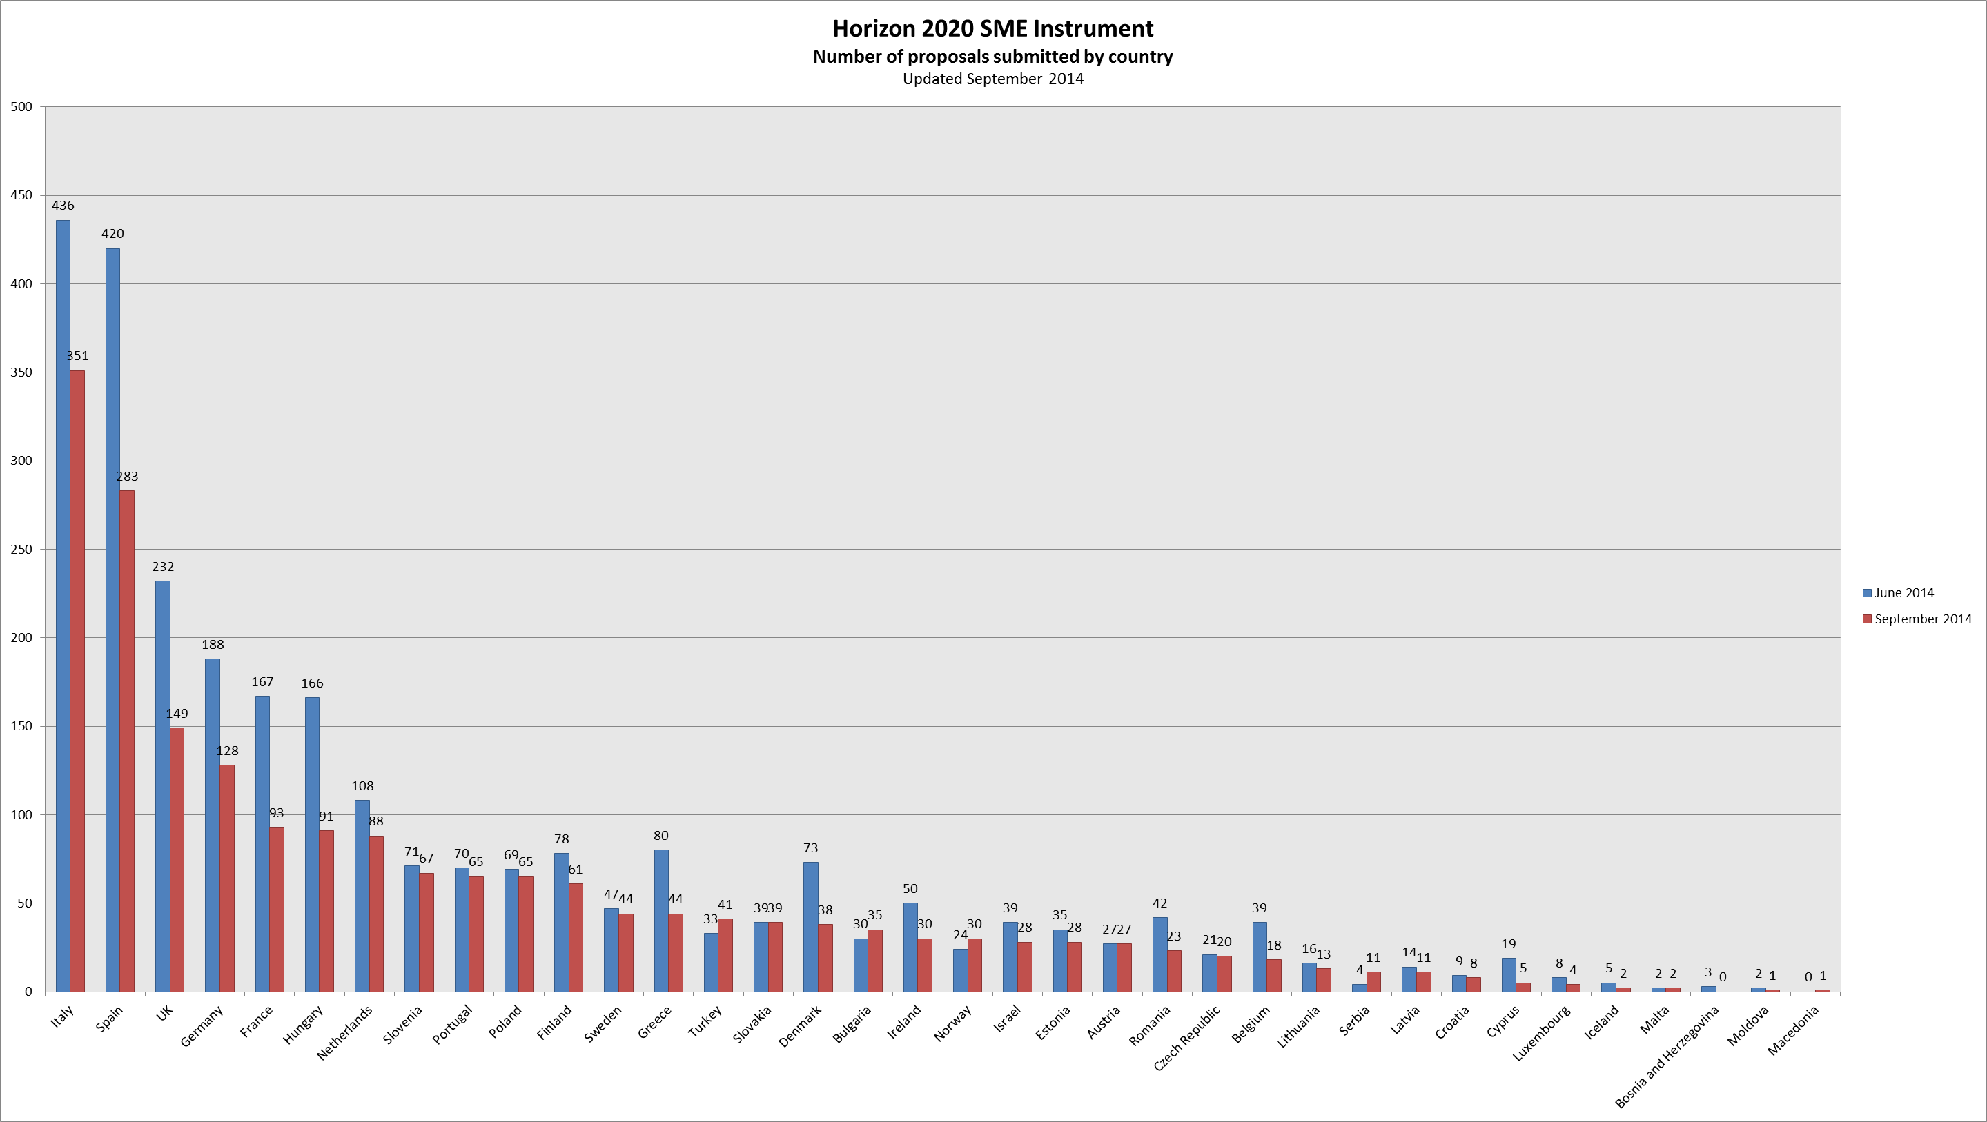
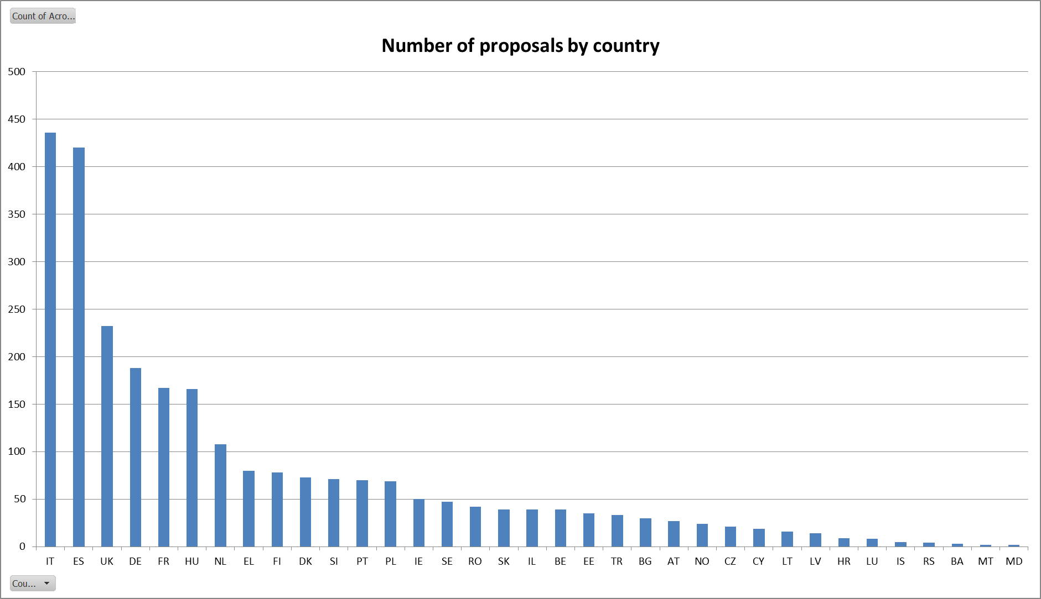
only countries with submissions are shown

Slide 10
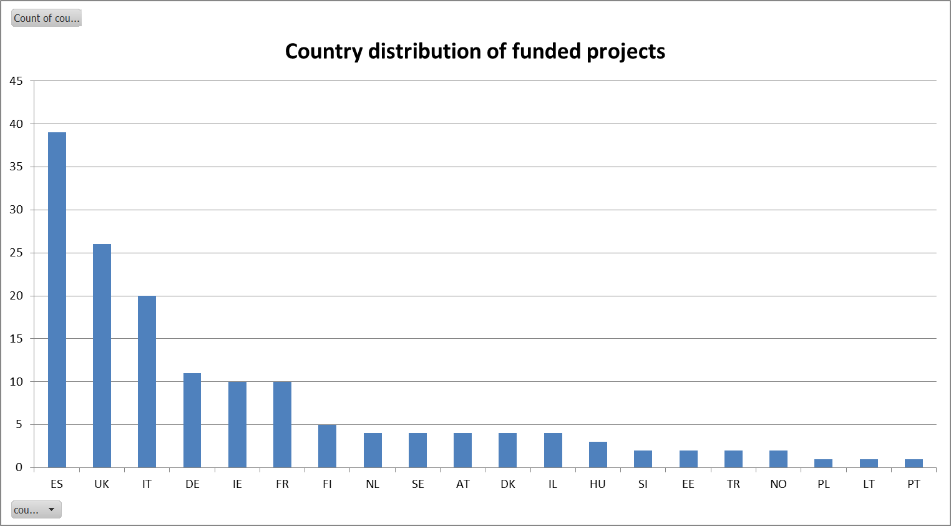
The 5 highest "country success rates" are:
Ireland: 20%
Austria: 15%
United Kingdom: 11%
Israel: 10%
Spain: 9%

Slide 11
First analysis of reasons for unsuccessful phase 1 proposals:
Too much project focussed, not enough business opportunity oriented
Description of company not convincing (why would this company succeed and not the competitor?!)
No information on competing solutions
Innovation content too low; product exists already on the market (just incremental improvement)
Just ideas, no proof of existing commercialisation concept (TRL far too low)
Just trying one's luck

Slide 12
Lessons learned and aspects for improvement:
Submission process not yet optimal (85% of the submitted proposals arrived within the last 48h prior to the cut-off date).
Presentation of the call at proposal submission level is not yet optimal (70 proposals had to be transferred from one topic to another upon request by the applicants, with the majority of the cases due to misinterpretation of the applicant).
Level of feedback from evaluation to applicants will be improved, yet speed (short time-to-grant) will remain the most important preoccupation.
Pool of evaluators will be broadened from current 521 to about 1000 (more business, financial profiles!)

Slide 13
ACCESUL LA FINANȚAREA DE RISC
Forumul Inovarii, Bucuresti 16 octombrie 2014

Slide 14
ACCESUL LA FINANȚAREA DE RISC Priorități pe termen scurt: - Continuarea activităților care s-au dovedit eficiente în sprijinul acordat cercetării și inovării în perioada 2007-2013; - Orientarea accesului la finanțarea de risc către firmele mijlocii (‘midcaps’). INSTRUMENTE DE FINANȚARE 1. Mecanismul de împrumut – Debt Financing 2. Mecanismul de capitaluri proprii – Equity Financing
Forumul Inovarii, Bucuresti 16 octombrie 2014

Slide 15

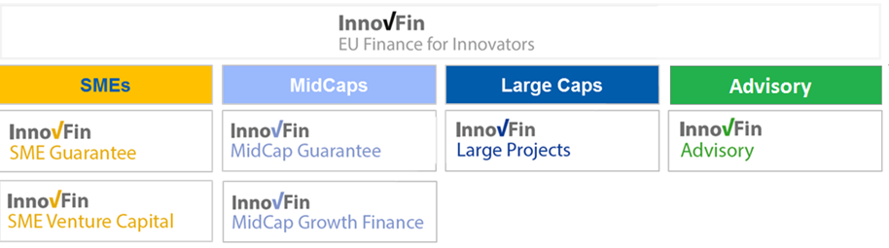
SMEs and small Mid-Caps
< 500 Employees
Mid-Caps
< 3,000 Employees
Large Caps
Typically > 3,000 Employees
Intermediated
SME/Mid-Cap Financing
Intermediated and/or direct Corporate lending
Direct Corporate Lending
Forumul Inovarii, Bucuresti 16 octombrie 2014

Slide 16

- Enhancing a successful pilot initiative
EIF issues guarantees and counter-guarantees to selected financial intermediaries, allowing them to provide loans, financial leases and loan guarantees to innovative SMEs and small midcaps
InnovFin SME Guarantee will boost by almost 4 times the RSI pilot, so providing €8 bn to €10 bn of financing to benefit innovative SMEs and small midcaps over the next 7 years
EIF published Call for Expression of Interest — financial intermediaries across Europe invited to apply – google 'innovfin sme guarantee eif' http://www.eif.org/what_we_do/guarantees/single_eu_debt_instrument/innovfin-guarantee-facility/index.htm
Forumul Inovarii, Bucuresti 16 octombrie 2014

Slide 17
MidCap Guarantee - rolled out through financial intermediaries guaranteed against a portion of their potential losses by EIB. - guarantees and counter-guarantees on debt financing <€50 million - for innovative midcaps (< 3000 FTEs) not eligible under InnovFin SME Guarantee Mid Cap Growth Finance - Direct long term senior, subordinated or mezzanine loans from EIB €7.5 mn < €25 mn - for innovative larger midcaps (< 3000 FTEs), but also SMEs and small midc
for MidCaps
Forumul Inovarii, Bucuresti 16 octombrie 2014

Slide 18
- Direct loans and guarantees from EIB for larger projects - €25 mn to €300 mn (more in exceptional cases) - R&I projects emanating from larger firms - universities and public research organisations - R&I infrastructures (including innovation-enabling infrastructures) - public-private partnerships; - special-purpose vehicles or projects
Large Projects
Forumul Inovarii, Bucuresti 16 octombrie 2014

Slide 19

Project advisory work - Improve bankability and investment readiness of large, complex R&I projects - Advise specific public-private consortia, R&I driven companies (midcaps or larger), Joint Technology Initiatives, PPPs, R&I clusters, EC and MS Horizontal activities - Improve framework conditions for access to finance (web-based portal, criteria notes,…) - Prepare studies to improve effectiveness of H2020 FI to address specific sectors/R&I projects needs - Develop “business case” for new financing mechanisms to support specific R&I policy objectives
Activities
Forumul Inovarii, Bucuresti 16 octombrie 2014

Slide 20

- Improve access to risk finance by early-stage RDI-driven SMEs (and small midcaps) located in Member States or in Horizon 2020 Associated Countries - Support early-stage risk capital funds (via EIF) that invest, on a predominantly cross-border basis, in individual enterprises. - COSME programme's Equity Facility for Growth (EFG) complements this facility by focusing on growth-stage SMEs. - Pro-rata funding for multistage funds - With EU financial contribution ca. €0.4 bn (2014-2020), leverage effect expected of at least 5 (i.e. total investments of VC funds supported of at least €2 bn) - Signature and launch foreseen by end-2014. MEN va organiza un eveniment cu reprezentantii EIB la Bucuresti in Martie-Aprrilie 2015!
Horizon 2020 Early-Stage Equity Facility
Forumul Inovarii, Bucuresti 16 octombrie 2014

Slide 21
Adrese utile Horizon 2020 General portal http://ec.europa.eu/research/horizon2020/index_en.cfm?pg=home&video=none http://orizont.research.edu.ro/ http://ec.europa.eu/enterprise/policies/sme/index_en.htm Contact: orizont2020@ancs.ro Horizon 2020 Financial Instruments RSFF: http://www.eib.org/products/rsff/ RSI : www.eif.org/what_we_do/guarantees/RSI/index.htm EU Access to Finance Specific portal: www.europa.eu/youreurope/business/index_en.htm
Forumul Inovarii, Bucuresti 16 octombrie 2014

Slide 22
Mulțumesc pentru atenție !
Forumul Inovarii, Bucuresti 16 octombrie 2014

